Slide 1

Home Insurance Classification Project
Linoy E., Roni S. and Shai F.
October 2021
Link to Notebook

Slide 2
Overview
Dataset and Objective
EDA
Data Transformation
Data Enrichment (added two csv files; using scraping library BeautifulSoup)
Feature Engineering
Handling Missing Values
Pre-Processing
Handling Data Imbalance
Classification Models
Decision Tree Classifier
Random Forest Classifier
Logistic Regression
ADABoost Classifier
Model Comparison
Discussion and Summary
Further Analysis

Slide 3
Dataset and Objective
The dataset contains 12,398 rows, each representing a single Lemonade insurance policy (www.lemonade.com), an online-only insurance company with over 1 million customers. The dataset was received as a csv file ("home-insurance-raw-data.csv“) with no additional information.
The dataset contains 16 columns:
ID – assumed to be a unique identifier representing a single insurance policy.
State – data contains 21 states out of the 50 U.S. states.
Postal code – data contains 2,565 unique codes out of 41,692 different postal codes in the U.S.
Product - ho3, ho4, ho6.
User ID – assumed to be a unique customer identifier (one customer can have more than one policy).
Square feet - area of the insured home.
High risk dog - assumed to be presence of a high-risk dog in the insured home.
Has fire alarm - presence of fire alarm in insured home.
Has burglar alarm – presence of burglar alarm in insured home.
Portable electronics – presence of portable electronics in the insured home.
Coast – assumed to be distance in miles to nearest coast.
Fire housing proximity – a community’s fire risk classification grade, on a scale of 1-10 (1 is safest) *.
Previous policies – number of customer’s previous policies.
User age
Card type - debit, credit and prepaid.
Target – Occurrence of a claim in the insurance policy.
Objective
Predict the occurrence of an insurance claim based on features of insurance policies.
* See: www.verisk.com/insurance/visualize/new-ppc-fire-protection-classes-to-benefit-insurers-communities/

Slide 4
EDA
Initial analysis:
72 duplicate values in “id” column (“id” is assumed to be a unique insurance policy identifier)
97.7% missing values in “square_ft” column.
Some missing values in “portable electronics”, “coast”, “user_age”, and “card_type” columns.
Preliminary transformations and fixes:
Converted postal code to 5-character string (by adding “0”s to 4-character codes).
Converted state abbreviations to full name (i.e. NY -> New York, TX -> Texas).
Changed “target”, “has_fire_alarm” and “has burglar_alarm” from True/False to 1/0.
Dropped 72 rows which had duplicate policy id numbers (0.6% data loss).

Slide 5
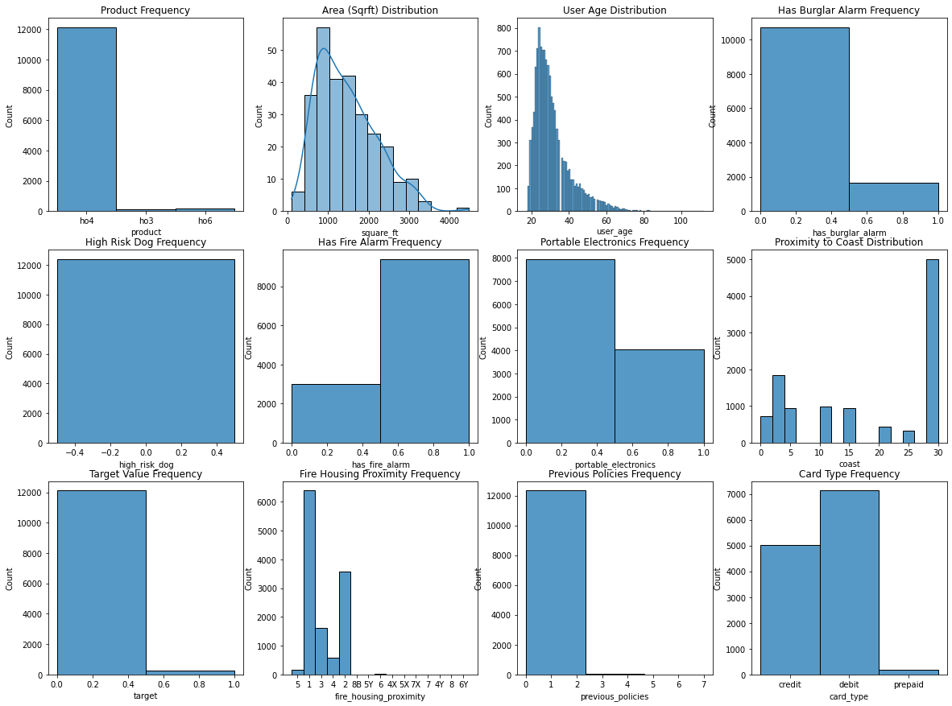
EDA
High Risk Dog - no “True” values (all “False”)
Target extremely imbalanced (97.7% False)

Slide 6
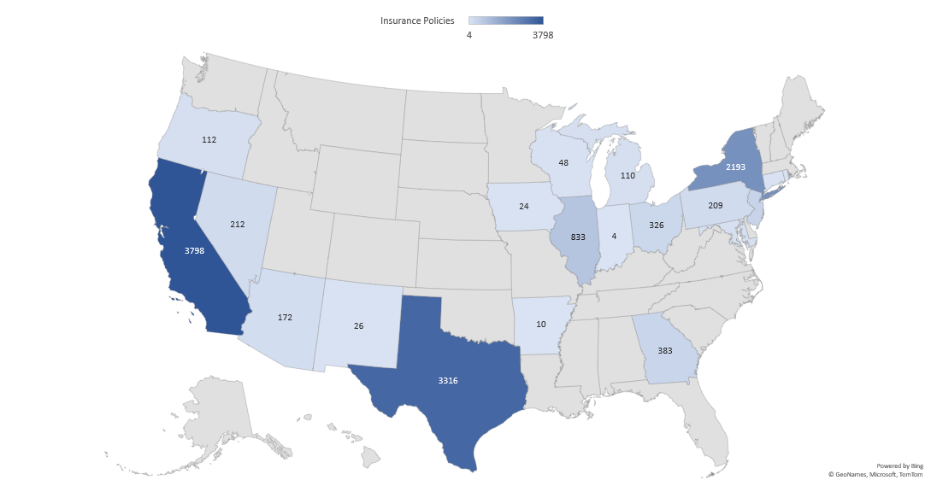
EDA
Number of Insurance Policies by State

Slide 7
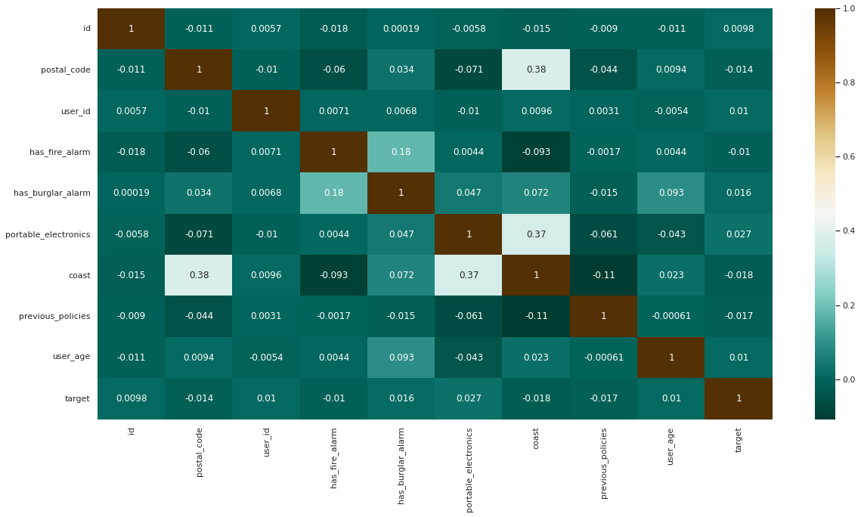
Correlation Matrix
No significant correlation of any feature with the target variable.
Almost no observable correlations between the different features.
Small correlation between coast and postal_code (0.38) and between coast and portable_electronics (0.38).

Slide 8
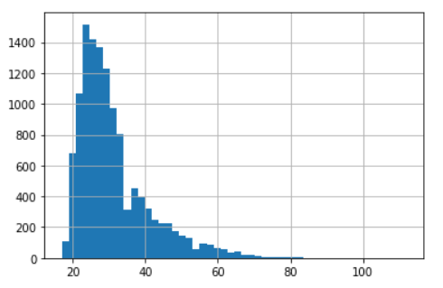
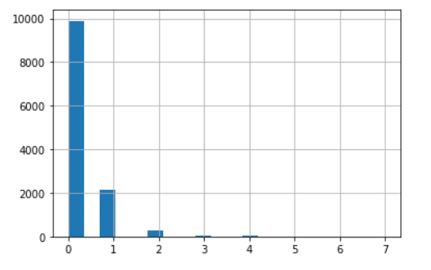
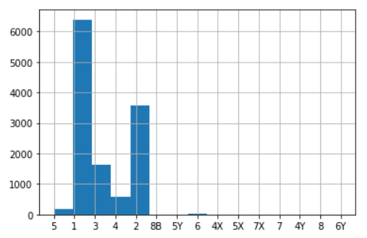
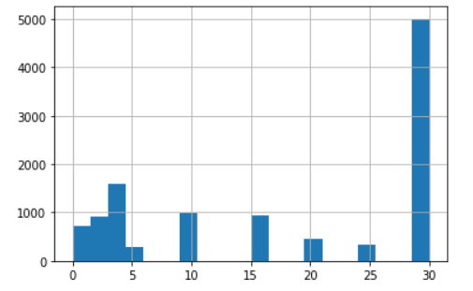
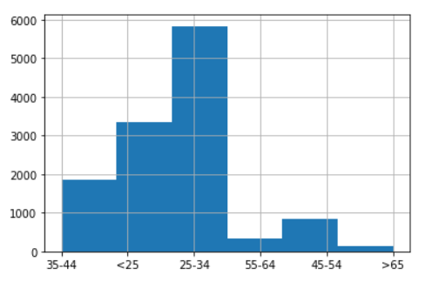
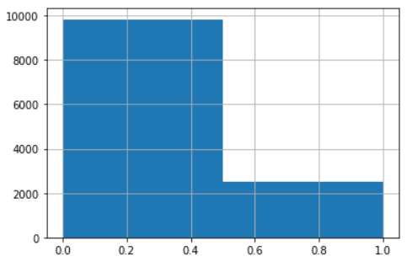
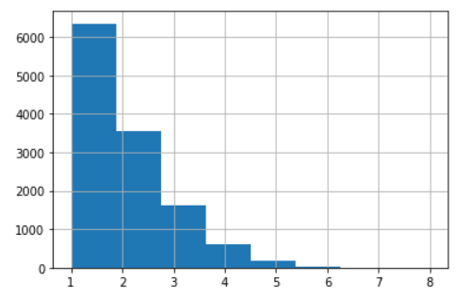
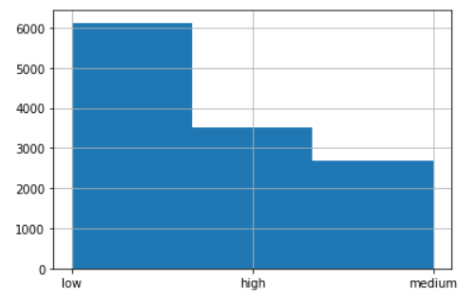
Data Transformation
User Age
Previous Policies
Fire Housing Proximity
Coast
Grouped to 6 categories:
(‘user_age_cat’)
under 25
25 - 34
35 - 44
45 - 54
45 - 55
over 65
Grouped 8 values into 2 categories
(‘has_previous_policies’)
Zero previous policies
One or more previous policies
Grouped 15 string values into 8 categories according to numerical value (1-8)
Grouped into three categories
(‘close_to_coast_risk’)
High risk (0-5 miles from coast)
Medium risk (6-29 miles from coast)
Low risk (30+ miles from coast or NaN)

Slide 9
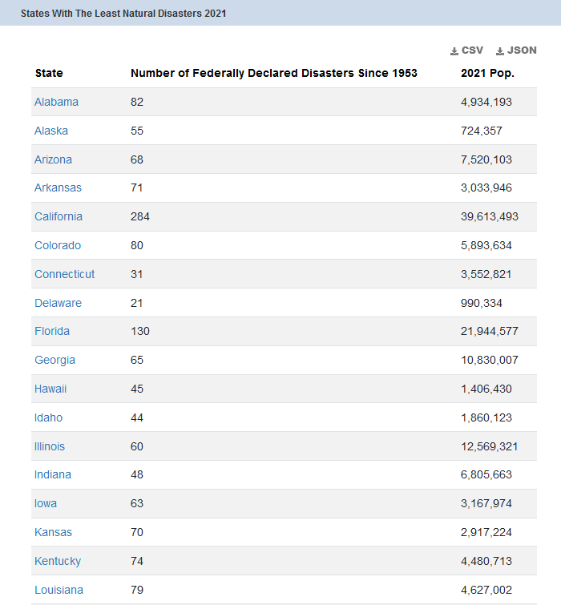
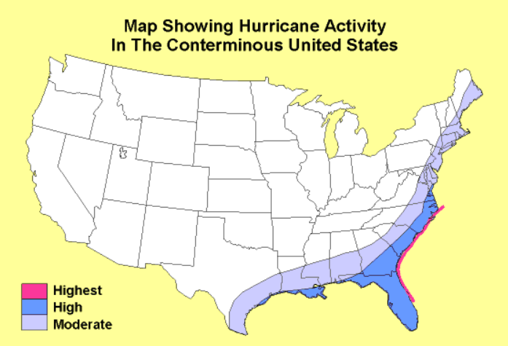
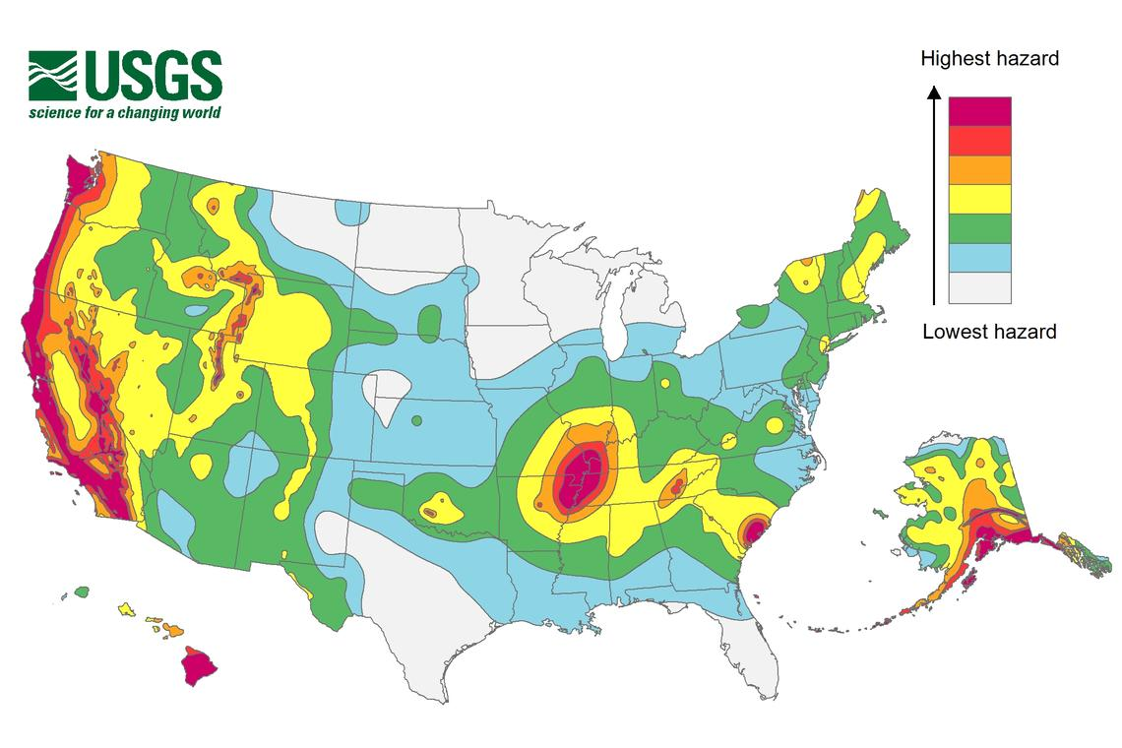
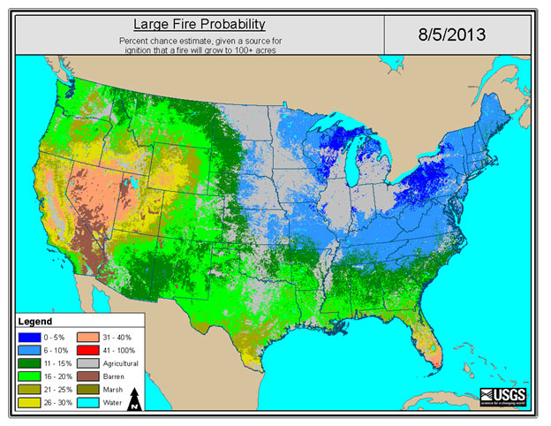
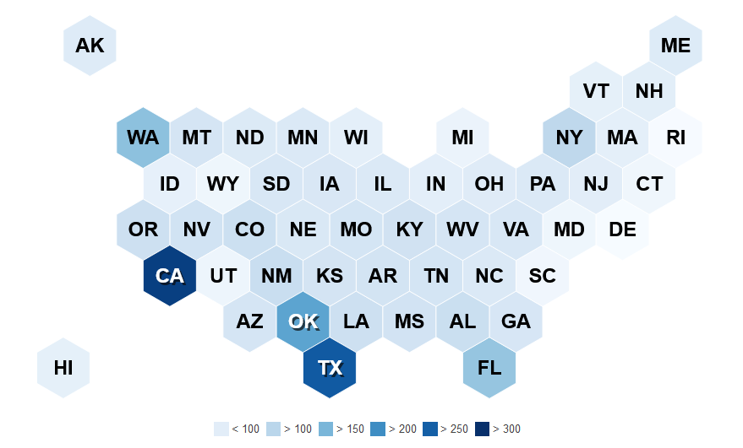
Data Enrichment
https://worldpopulationreview.com/state-rankings/states-with-the-least-natural-disasters
Hurricane Activity
Earthquake Risk
Large Fire Probability
Number of Natural Disasters Since 1953

Slide 10


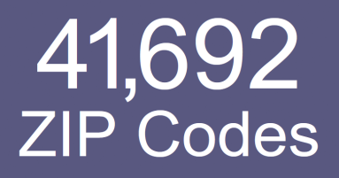

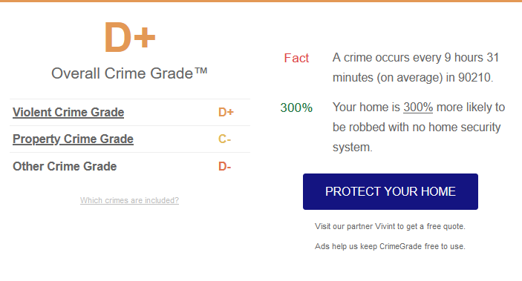
#---- WEB SCRAPER USING BEAUTIFUL SOUP LIBRARY---
Create sorted list of zip codes
zip_set=set(df.ZipCode)
zip_list_temp = list(zip_set)
zip_list=sorted(zip_list_temp)
num_zip=len(zip_list)
print('Number of different zip codes:',num_zip)
Scrape crime grades for zipcodes from crimegrade.org
data_dict = {'ZipCode': [],
'crime_grade': []}
zip_code_query = zip_list
for query in zip_code_query:
url= "http://crimegrade.org/safest-places-in-"+query
req = Request(url , headers={'User-Agent': 'Mozilla/5.0'})
try:
webpage = urlopen(req).read()
except Exception:
print ('Error')
crime_grade='Error'
data_dict['ZipCode'].append(query)
data_dict['crime_grade'].append(crime_grade)
continue
soup = bs(webpage, "html.parser")
get_grade=soup.find(class_="overallGradeLetter")
crime_grade=get_grade.get_text()
data_dict['ZipCode'].append(query)
data_dict['crime_grade'].append(crime_grade)
zip_df = pd.DataFrame(data=data_dict)
#Write scrape results to file (in order not to do repeated scrapes from same IP)
f = open('scrape.csv', 'a')
zip_df.to_csv(f, index = False)
f.close()
Crime Grade
Postal Code

Slide 11
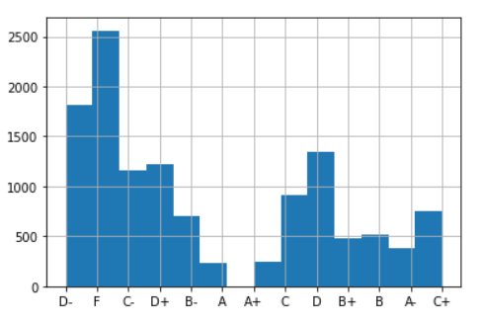
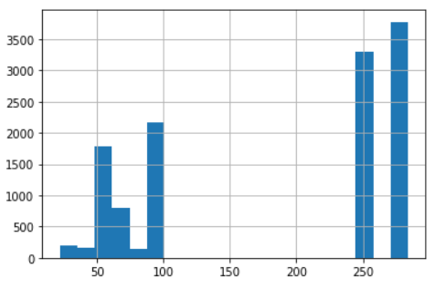
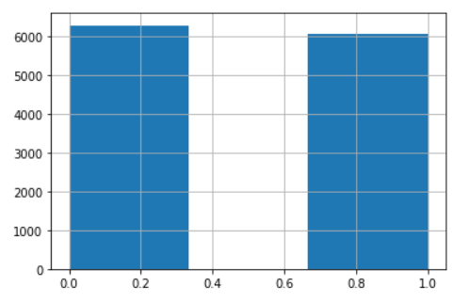
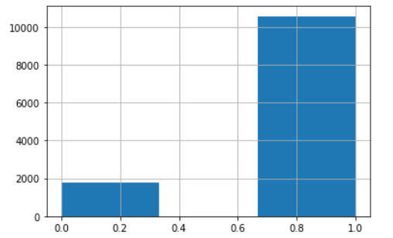
Feature Engineering – Adding New Columns
Added ”disasters” – number of natural disasters in each state as recorded from 1953*
Added ”crime_grade” – crime classification grade per zip code based on number of crime incidents (burglary, arson, etc. in the area). Data was scraped from crimegrade.org.**
Added “has_multiple_policies” – “0” for one policy / “1” for multiple policies, based on recurring user_ids.
Added “is_coastal_state” – “1” for states situated on east, west or gulf coasts / “0” for state with no ocean coast.
Crime Grade
Disasters
Has Multiple Policies
Is Coastal State
* from https://worldpopulationreview.com/state-rankings/states-with-the-least-natural-disasters
** value for each unique postal code scraped from https://crimegrade.org

Slide 12
Dropping Redundant Columns
Columns dropped:
id - unique identifier for each row - does not contribute to the analysis.
user_id - has no meaning by itself, substituted with 'has_multiple_policies’.
high_risk_dog – all values are “false” - does not contribute to analysis.
coast - substituted with 'close_to_coast_risk’ (low, medium, high).
previous_policies - substituted with 'has_previous_policies’ (boolean).
postal_code – data contains 2,565 unique postal codes (out of over 40,000 possible values) and many of them appear only once or twice. We substituted this with ’crime_grade’, which is relevant feature of postal_code in terms of insurance.
square_ft – only 278 rows (out of 12,398) contain values, of these only 9 have “true” in the target variable. We considered filling missing values NaN with mean square_ft of the data sample, mean square_ft of each postal code, of each state, or in all U.S (possibly from external source), but decided to drop this column entirely.

Slide 13
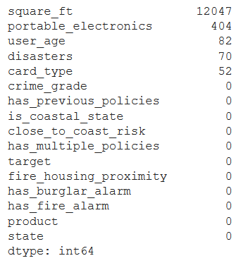
Handling Missing Values
square_ft - considered filling with mean square footage, but there are too many missing values, so we dropped the entire column.
portable_electronics - filled missing values with new label ‘no info’.
user_age – filled missing values with mean value.
disasters (enriched data) – all 70 missing values are from District of Columbia (not a state), so we filled with the value for the state of Maryland.
card_type - filled missing values with new label ‘no info’.

Slide 14
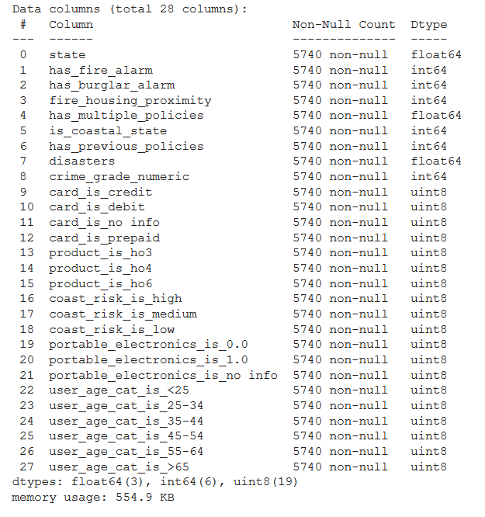
Pre-processing
X-train
Changed crime grades (A+,B, F etc.) to numeric grade scale (1-100).
Applied dummy variables to 5 categorical features (product, card_type, close_to_coast_risk, portable_electronics, user_age_cat) and dropped categorical columns.
Duplicate rows: After all values were numerical and all redundant columns were dropped (specifically id, user_id and postal_code) we checked for duplicate rows and removed them. Results: 5,150 rows removed; 7,175 rows remain. (41.8% removed)
Split the data using train_test_split (80/20).
Applied target encoding to one categorical feature of only the train set (state).
Applied MinMaxScaler to all values.

Slide 15
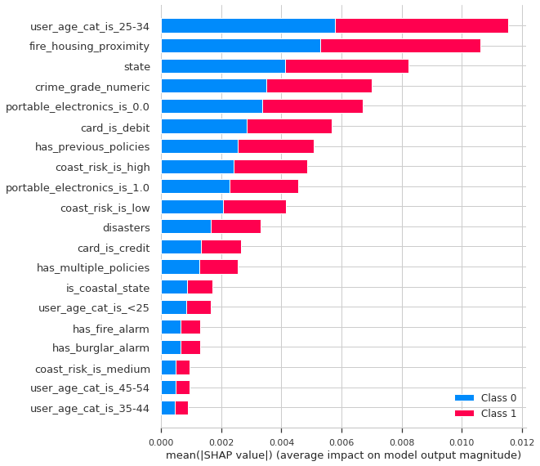
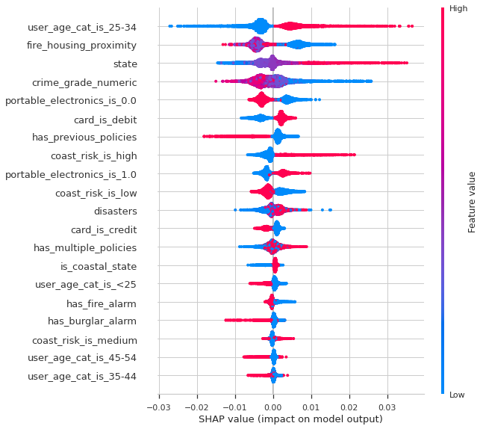
SHAP Values
SHAP (SHapley Additive exPlanations) is a unified approach to explain the output of any machine learning model. SHAP connects game theory with local explanations, uniting several previous methods and representing the only possible consistent and locally accurate additive feature attribution method based on expectations.
https://towardsdatascience.com/explain-your-model-with-the-shap-values-bc36aac4de3d

Slide 16
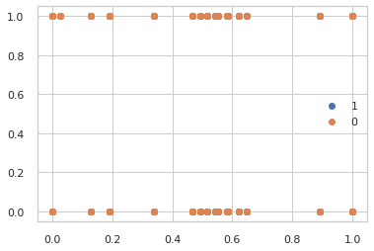
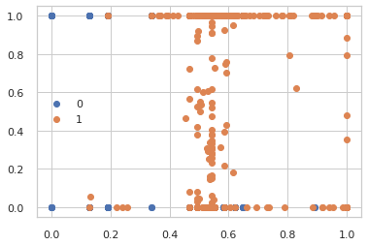
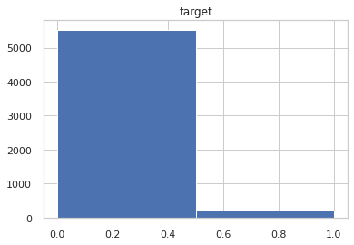
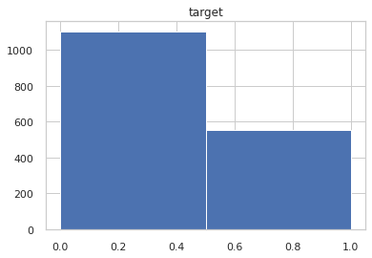
Handling Data Imbalance
Over-sampling illustration
Applied oversampling to the minority class (train set only) with goal to get 10 percent of the number of examples in the majority class (from 211 to 552). Technique used: SMOTE (Synthetic Minority Oversampling Technique) provided by the imbalanced-learn Python library in the SMOTE class.
Applied under sampling to achieve 2:1 ratio with the minority class (from 5529 to 1104).
Train set now has 1,656 rows (1104 “0”s / 552 “1”s)
After over-sampling and under-sampling
Original imbalanced data
5529
1104
552
211
https://machinelearningmastery.com/smote-oversampling-for-imbalanced-classification/

Slide 17
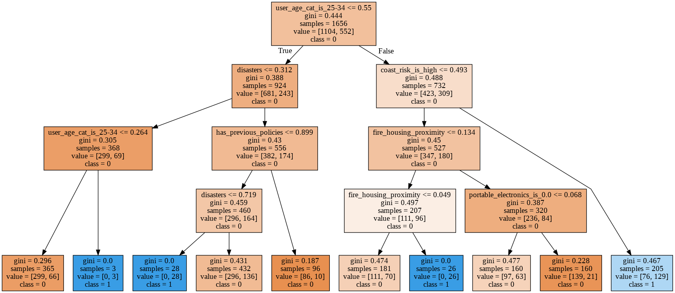
Initial Decision Tree Classifier Visualization
Splitter = ‘random’ (default: ‘best’)
MaxDepth = 4
MaxLeafNodes = 10
Min Sample Leaf = 3

Slide 18
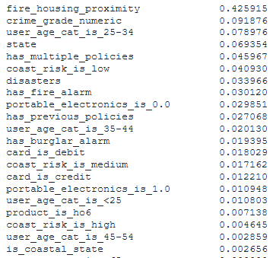
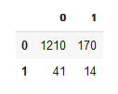
Decision Tree Classifier (Grid Search : 10-fold cv)
dt_param_grid = {
'max_depth': [3, 7, 12],
'min_samples_leaf': [5, 15, 40],
#'max_leaf_nodes': [5,8],
'min_samples_split': [3, 5, 10]}
Best Parameters:{'max_depth': 12,'min_samples_leaf': 5, 'min_samples_split': 3}
Feature Importance
GS with f1 scoring
Confusion Matrix
Score | Metric
85% | Accuracy
8% | Precision
25% | Recall
82% | f1 (train)
12% | f1 (test)
57% | AUC
0.38 | RMSE
GS with auc-roc scoring
produces the same hyper-parameters

Slide 19


Random Forest Classifier (Grid Search : 5-fold cv)
rf_param_grid = {'n_estimators':[100, 500, 1000],
'max_depth':[4, 12, 16],
#'min_samples_leaf': [1, 2, 4],
'criterion':['gini','entropy']}
GS with f1 scoring
GS with auc-roc scoring
Best Parameters: {'criterion':'gini', 'max_depth': 16, 'n_estimators': 500}
Best Parameters: {'criterion':'entropy', 'max_depth': 12, 'n_estimators': 500}
Score | Metric
90% | Accuracy
7% | Precision
12% | Recall
98% | f1 (train)
9% | f1 (test)
53% | AUC
0.32 | RMSE
Confusion Matrix
Score | Metric
92% | Accuracy
8% | Precision
11% | Recall
92% | f1 (train)
9% | f1 (test)
53% | AUC
0.29 | RMSE
Confusion Matrix

Slide 20


Logistic Regression (Grid Search : 10-fold cv)
lr_param_grid =
{'C': [0.001, 0.01, 0.1, 1, 10],
'tol': [0.001, 0.0001]}
GS with f1 scoring
GS with roc-auc scoring
Best Parameters: {'C': 10, 'tol': 0.001}
Best Parameters:{'C': 1, 'tol': 0.001}
Score | Metric
85% | Accuracy
8% | Precision
29% | Recall
44% | f1 (train)
13% | f1 (test)
58% | AUC
0.38 | RMSE
Confusion Matrix
Score | Metric
86% | Accuracy
8% | Precision
25% | Recall
42% | f1 (train)
12% | f1 (test)
57% | AUC
0.37 | RMSE
Confusion Matrix

Slide 21
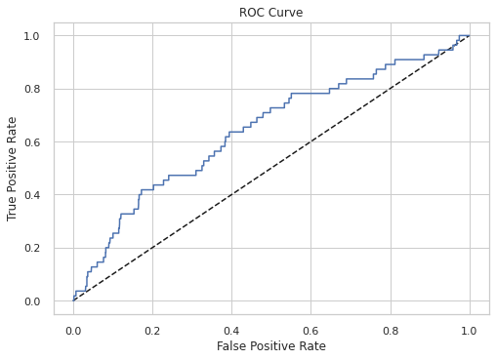
Logistic Regression – ROC Curve (Receiver Operating Characteristics Curve)

Slide 22

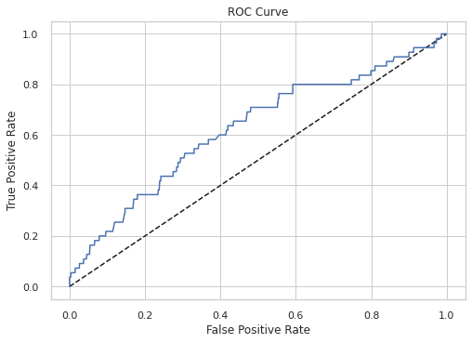
ADA Boost Classifier (Grid Search : 5-fold cv)
AdaBoost (Adaptive Boosting) – fitting a sequence of weak learners on repeatedly modified versions of the data. In each iteration, misclassified samples from the previous iteration are given higher weights, while the correctly-classified samples are given lower weights.
ada_param_grid = {'n_estimators': [100, 1000], 'learning_rate': [0.01, 0.001]}
Best Parameters: {'learning_rate': 0.01, 'n_estimators': 1000}
GS with f1 scoring
GS with auc-roc scoring
Confusion Matrix
produces the same hyper-parameters
Score | Metric
93% | Accuracy
9% | Precision
9% | Recall
37% | f1 (train)
9% | f1 (test)
53% | AUC
0.26 | RMSE

Slide 23
Model Comparison: Confusion Matrices
Logistic Regression
Decision Tree
Random Forest
ADA Booster
Highest % of correct predictions of positives but at the cost of many false positives (173)
Lowest % of false positives (50) but at the cost of fewer correct predictions of positives (5)

Slide 24
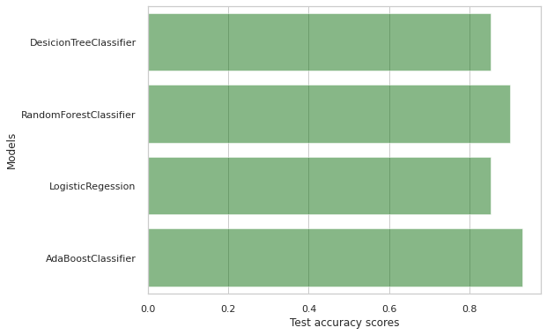
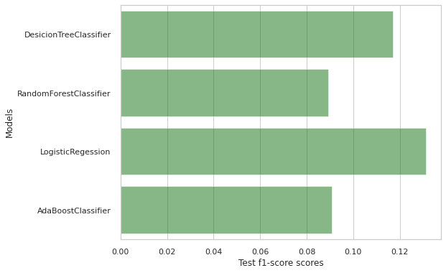
Model Comparison - Metrics
Model | Accuracy | Precision | Recall | RMSE | f1-score | roc_auc
Logistic Regression | 0.852265 | 0.084656 | 0.290909 | 0.384363 | 0.131148 | 0.582773
Decision Tree Classifier | 0.852962 | 0.076087 | 0.254545 | 0.383456 | 0.117155 | 0.565679
ADA Boost Classifier | 0.930314 | 0.090909 | 0.090909 | 0.263982 | 0.090909 | 0.527339
Random Forest Classifier | 0.900348 | 0.068627 | 0.127273 | 0.315676 | 0.089172 | 0.529216
Results by Accuracy
Results by f1 score

Slide 25
Implementing Pipeline
Applying GridSearch
To Pipeline
encoder = TargetEncoder(cols=['state'])
scaler = MinMaxScaler()
# selector = SelectKBest(k=5) # optional
over = SMOTE(sampling_strategy=0.1, k_neighbors=4)
under = RandomUnderSampler(sampling_strategy=0.5)
model = LogisticRegression()
steps = [('encoder', encoder),
('scaler', scaler),
# ('selector', selector),
('over', over),
('under', under),
('model', model)]
pipeline = Pipeline(steps)
pipeline.fit(X_train, y_train)
#….and so on and so forth…
params = {'over__sampling_strategy': [0.1, 0.2],
'over__k_neighbors': range(3, 5),
'under__sampling_strategy': [0.3, 0.5],
'model__C': [0.01, 0.1, 1]}
gs = GridSearchCV(pipeline, param_grid=params, cv=10,
scoring='f1') # verbose=3
gs.fit(X_train, y_train)

Slide 26
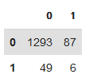
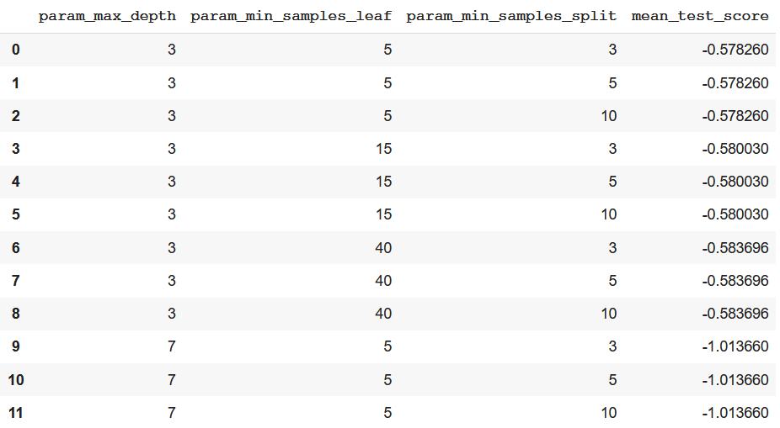
Log Loss (Random Forest Grid Search with Log Loss Scoring)
Best Parameters: {'criterion':'entropy', 'max_depth': 16, 'n_estimators': 1000}
Confusion Matrix
from sklearn.metrics import log_loss, make_scorer
LogLoss = make_scorer(log_loss, greater_is_better=False, needs_proba=True)
grid_dt_logloss = GridSearchCV(DecisionTreeClassifier(random_state=42), param_grid=dt_param_grid, scoring=LogLoss, cv=10)
grid_dt_logloss.fit(X_train, y_train)
Score | Metric
90% | Accuracy
6% | Precision
11% | Recall
98% | f1 (train)
8% | f1 (test)
52% | AUC
0.3 | RMSE

Slide 27
Discussion and Summary
Relevant Metrics
Recall - Insurance company will want to minimize false-negatives (falsely predicting risky policies that end in insurance claims) on order to minimize payouts. So will want to maximize recall.
Precision – Insurance company will also want to minimize false-positives (falsely predicting safe policies) in order to maximize income from selling insurance.
In our opinion, paying out insurance claims will have a higher impact on the company’s profit than missing potential income from insurance policies not being sold.
Therefore, from a business perspective, recall is a better metric than precision. The f1 metric is also useful because it balances these two metrics. An f2 metric may be even better as it puts more weight to recall.
Model
The logistic regression model gives the best results on recall, f1 and ROC-AUC metrics .
The ADABoost model gives the best results on accuracy, precision and RMSE metrics.

Slide 28
Further Analysis
Investigate how to use the data for square feet (home size) – maybe filling in the blanks with mean size of home according to postal code.
Try other methods for handling imbalanced data: Penalizing - the class_weight argument
Try other scalers (StandardScaler, etc.)
Improving / tweaking hyperparameters for GridSearch fo the various models
Expand pipeline to include one-hot-encoder, split into pre-processing pipeline and model pipeline.
Additional models and boosters
K-Nearest Neighbors Classifier
XGBoost
CatBoost
LGBM
Look into a logloss metric (better handle probabilities) or RMSE metric
Try using a f2 metric (more weight to recall and less weight to precision)

Slide 29
Thank You

